Slide 1
Executives and their powers

Slide 2
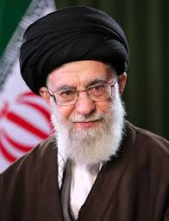
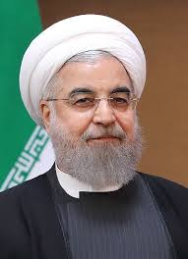
Iran
Supreme Leader
President
Reviews president’s actions/powers
Commander in chief
Approves foreign affairs
Appoints council members
Head of executive branch
Second in command of exec branch
Can declare state of emergency
Deputy commander in chief
Head of supreme national security council
Head of supreme council of the cultural revolution
Can appoint VP
Can nominate cabinet members
Sends and receives ambassadors
Issues executive orders (approval)
issues presidential pardons (approval)

Slide 3
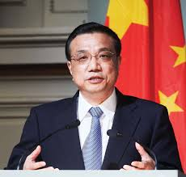
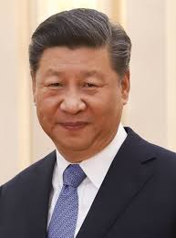
China
President
Premier/Prime Minister
On paper powers v powers as Gen Sec of CCP
Sign legislation
Propose legislation
meet with ambassadors
Signing treaties
Appoints and remove premier
Almost all powers require NPC approval
As party head
Appoint everyone who will vote for him
Appoint bureaucrats
Appoint judges
Set legislative priorities
Revolutionary army leader
International policies
Head of Government
Supervise the bureaucracy/government ministries, actions day to day, etc.
Help run NPC—propose legislation, etc.
Runs leadership committees

Slide 4
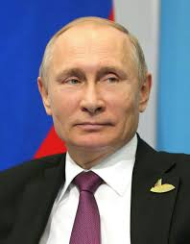
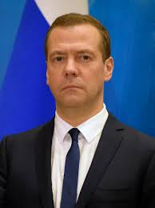
Russia
President
Prime Minister
Supposed to defend constitution
Moderate domestic and foreign policy
Commander-in-chief
Can propose, sign and veto laws to Duma
Can issue decrees
Can call for Duma elections, and disband Duma
Appoints prime minister
Recommends judge appointments
Oversees police and security administration
Declares states of emergency (emergency powers)
Can grant asylum and issue pardons
Makes national policy
Head of Government
Part of cabinet/advises president
Oversees Duma
Oversees bureaucracy (day to day running of government)

Slide 5
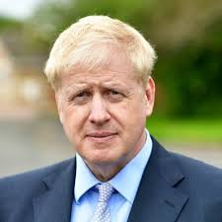
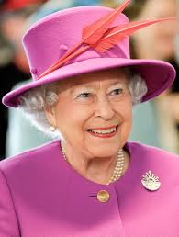
UK
Prime Minister
Queen
Can lead the government (Head of Government)
Appoint ministers (and dismiss)
Manage cabinet system (committees, appointments)
Can dissolve parliament and call general election
Supervise government—bureaucracy
Sign treaties
Can declare war (armed forces)
Limited by tradition & Parliament (practice)
Could not sign laws (never has)
Be consulted
Can encourage actions/opinion
Can warn
Represents country internationally (receive ambassadors, etc)

Slide 6
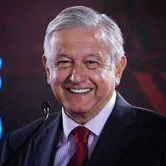
Mexico
Appoint and remove ministers/secretaries (including attorney general)
Appoint and remove foreign service, treasury officials, senior bureaucrats, all bureaucrats
Appoint ambassadors, council general, treasury (with confirmation vote from senate)
Appoints regulatory leaders (energy, economic, etc.)
Oversees security and intelligence
Commander in chief and appoints military leaders
Declare war (with congress)
Convene congress
Sign and propose and negotiate international treaties
Oversees foreign relations
Sign or veto legislation
Propose legislation
Grant pardons
Appoints judges

Slide 7
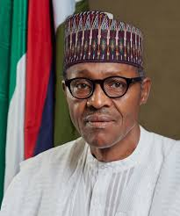
Nigeria
Head of government and head of state
Commander in chief of military
In charge of police
Ministries (advisors) and civil service (bureaucrats)
Federal commissions
Can pardon
Can appoint diplomatic corps
Veto or sign legislation
Refer bills to national assembly or supreme court
Nominate judges
Propose legislation
Issues executive orders
Receive and recognize diplomats
Appoint commissions of inquiry
Hindered by low-capacity government; power has stayed in hands of same people-- higher bureaucrats/ministries

Slide 8
Bureaucracy
BUREAUCRACIES Bureaucracies consist of agencies that generally implement government policy. They usually are a part of the executive branch of government, and their size has generally increased over the course of the 20th and early 21st centuries. This is partly due to government efforts to improve the health, security, and welfare of their populations. German political philosopher Max Weber created the classic conception of bureaucracy as a well-organized, complex machine that is a "rational" way for a modern society to organize its business. He did not see them as necessary evils, but as the best organizational response to a changing society

Slide 9
Weber’s characteristics of bureaucracy
Hierarchical authority structure - A chain of command that is hierarchical;
the top bureaucrat has ultimate control, and authority flows from the top down.
Task specialization - A clear division of labor in which every individual has a specialized job
Extensive rules - Clearly written, well-established formal rules that all people in the organization follow
Clear goals - A clearly defined set of goals that all people in the organization strive toward
The merit principle - Merit-based hiring and promotion; no granting of jobs to friends or family unless they are the best qualified
Impersonality - Job performance that is judged by productivity, or how much work the individual gets done

Slide 10
Bureaucracy
Bureaucracies have acquired great significance in most contemporary societies and often represent an important source of stability for states.

